Slide 1
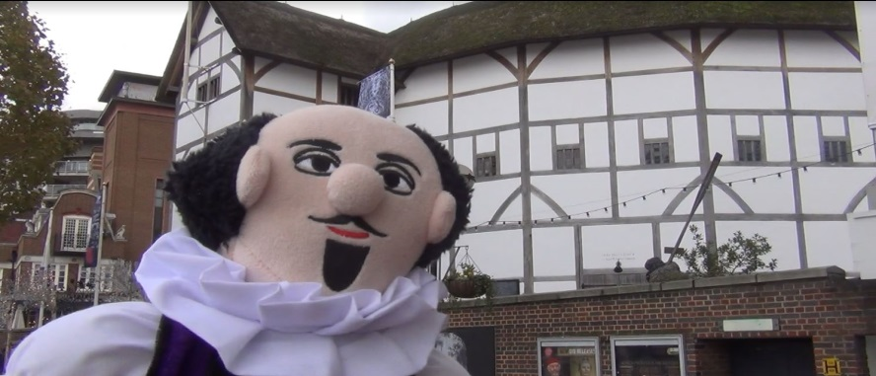
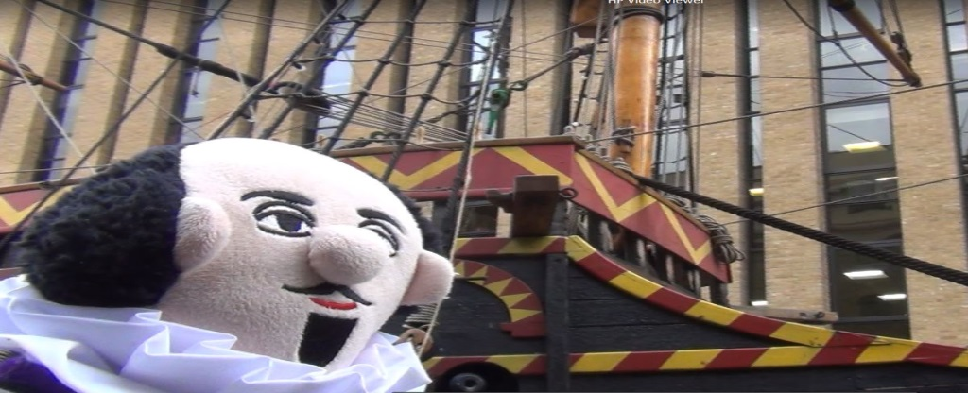
Invitation to Haymerle School Christmas Concert
Haymerle School proudly invites you to our most recent cinematic spectacular
Celebrating the life and works of our Southwark hero
In search of
William Shakespeare……or
We’re Going on a Bard Hunt!
Please come and join our celebrations at Haymerle School on
Friday 16th December 2016 You can sit with your child and their classmates to watch the show together.
Popcorn will be available for a small donation to be given to the charity ‘Shelter’
Please check at school for more information about times!!

